Slide 1
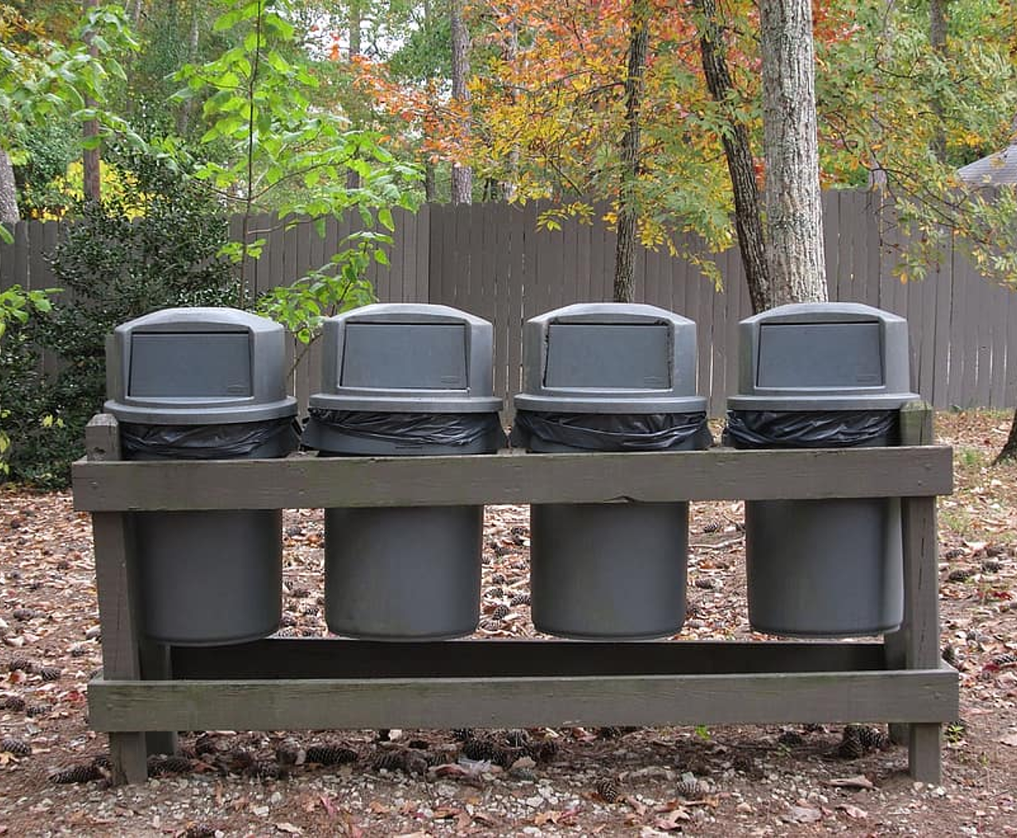
Why is littering bad?
Where: Hope Mills Library in the Activity Room
3411 Golfview Rd
For anyone interested, it's open to the public
Two opportunities:
Saturday, August 8th 1:15pm - 2:15pm
Saturday, August 22nd 3:00pm - 4:00pm
*This is part of a Girl Scout Silver Award Project*

