Slide 1
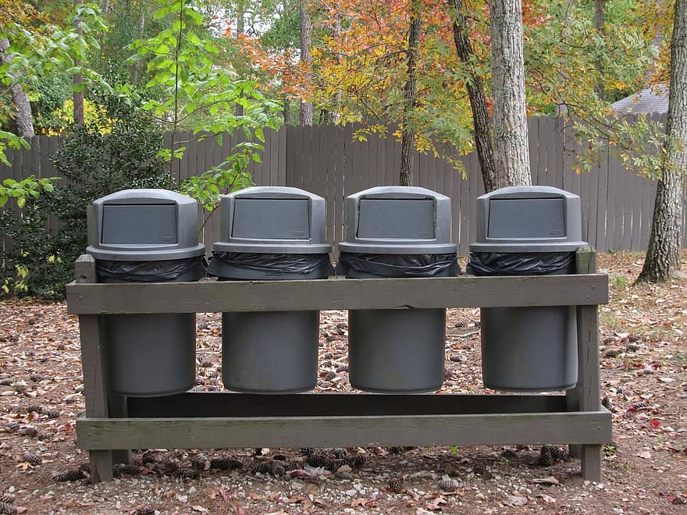
Trash Class
Made by me :p

Slide 2
What is litter?
Litter is waste or rubbish left in a public place.
Litter is usually cigarettes, plastic, old furniture, and sometimes food.
Litter is usually stuff that is thrown out windows of cars, open backs of vehicles, or people too lazy to find where they can throw out their litter.
How long does it take an average household bag of garbage to deteriorate? An average bag of household garbage takes anywhere from 10 to 1,000 years to completely break down, because modern landfills lack the oxygen, light, and moisture needed for decomposition so the process stalls, and it takes about 20 years for the garbage bag to deteriorate.

Slide 3
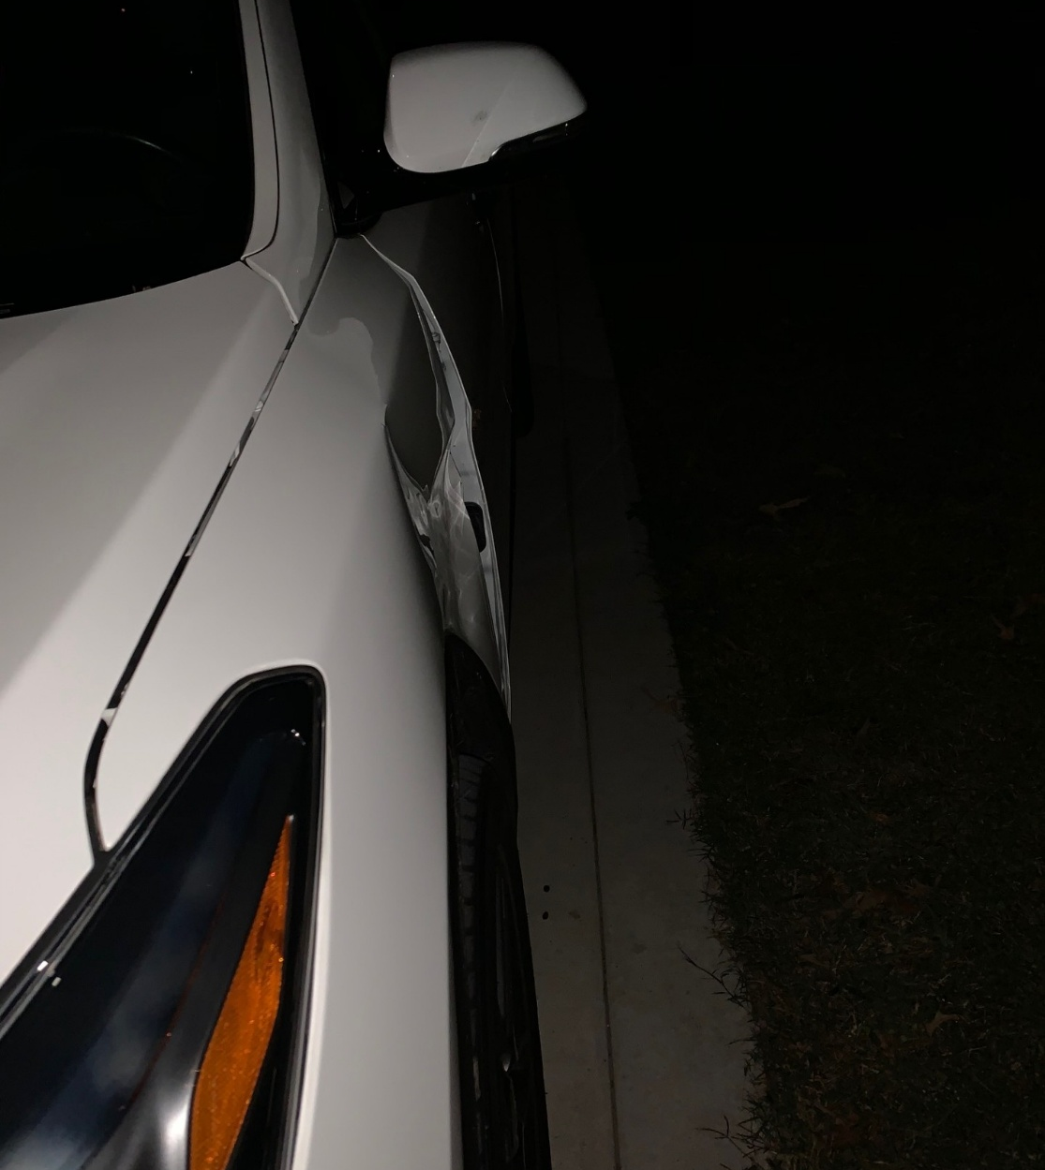
Roadkill
Roadkill is the body of an animal that has been hit or killed by a motor vehicle on a road
A safety concerns of roadkill:
  damage to a vehicle caused by hitting an animal
  Damage to a vehicle caused by hitting something attracted to the animal’s dead carcass, likely vultures. Vultures are the animal equivalent to garbage clean up.
Why roadkill happens. Roadkill can happen because people throw trash out on the road that attracts animals, the animal crosses a road to get the food, not knowing the dangers of the road, and they get hit by a vehicle.

Slide 4
Punishments of littering
Max punishments for Littering in the state.
  1st offense of 15 pounds or less, the max penalty is a
    $1,000 fine and
    up to 24 hours of community service.
  1st offense of 50 pounds, max penalty is a Class one felony.
Average punishment for littering in the state.
  1st offense of 15 pounds or less, is a Class 3 misdemeanor.
    This typically results $250 to $1,000 and
    up to 24 hours of community service picking up litter

Slide 5
Punishments
What is a Class 1 felony?
In North Carolina it is the least severe felony, it covers property crimes and lower-level drug offenses.
Punishments can range from 3 to 12 months in jail.
What is a Class 3 misdemeanor?
It is the least serious category of criminal offense, typically involving minor, non- violent violations such as simple marijuana possession, shoplifting of low-value items, or second-degree trespassing

Slide 6
Works Cited
Litter - Definition, Meaning & Synonyms | Vocabulary.com
ROADKILL Definition & Meaning - Merriam-Webster
Microsoft Word - S1014v8.doc
NCDOT: Litter Policies & Regulations
How Long Does It Take For Garbage To Decompose? - Waste Advantage Magazine
Class 1 Felony Sentencing - WinWithYoung.com
What is the new rule for Class 3 misdemeanor punishments? | UNC School of Government

